Slide 1

Research and Presentation on AWS Security Services –Group Activity

Slide 2
AMAZON GUARDDUTY
Overview
Amazon GuardDuty is a fully managed AWS threat detection service that uses machine learning and threat intelligence to identify suspicious activity in your AWS environment.

Slide 3
KEY FEATURES
Intelligent detection using AWS and third-party threat feeds
Analyzes AWS CloudTrail, VPC Flow Logs, DNS logs, and EKS audit logs
Provides detailed findings with severity ratings
Supports multi-account environments via AWS Organizations
Integrates with EventBridge for automated threat response
Includes malware scanning for EC2 and container workloads

Slide 4
USE CASES
Detect account compromises (e.g., unusual login behavior)
Identify compromised resources (e.g., crypto mining on EC2)
Monitor S3 buckets for data exfiltration attempts
Secure Kubernetes environments (EKS)
Support compliance efforts with continuous monitoring

Slide 5
BENEFITS
No infrastructure or maintenance required
Scales with your AWS usage
Reduces threat detection and response times
Integrates with AWS Security Hub and third-party tools
Free 30-day trial to test detection capabilities

Slide 6
OVERALL AWS SECURITY ARCHITECTURE
In the overall AWS security architecture, GuardDuty acts as an intelligent sentinel, continuously analyzing activity for threats, alerting security teams, and enabling automated responses. It enhances the security posture by providing real-time detection, helping organizations quickly identify and mitigate risks across their AWS workloads.

Slide 7
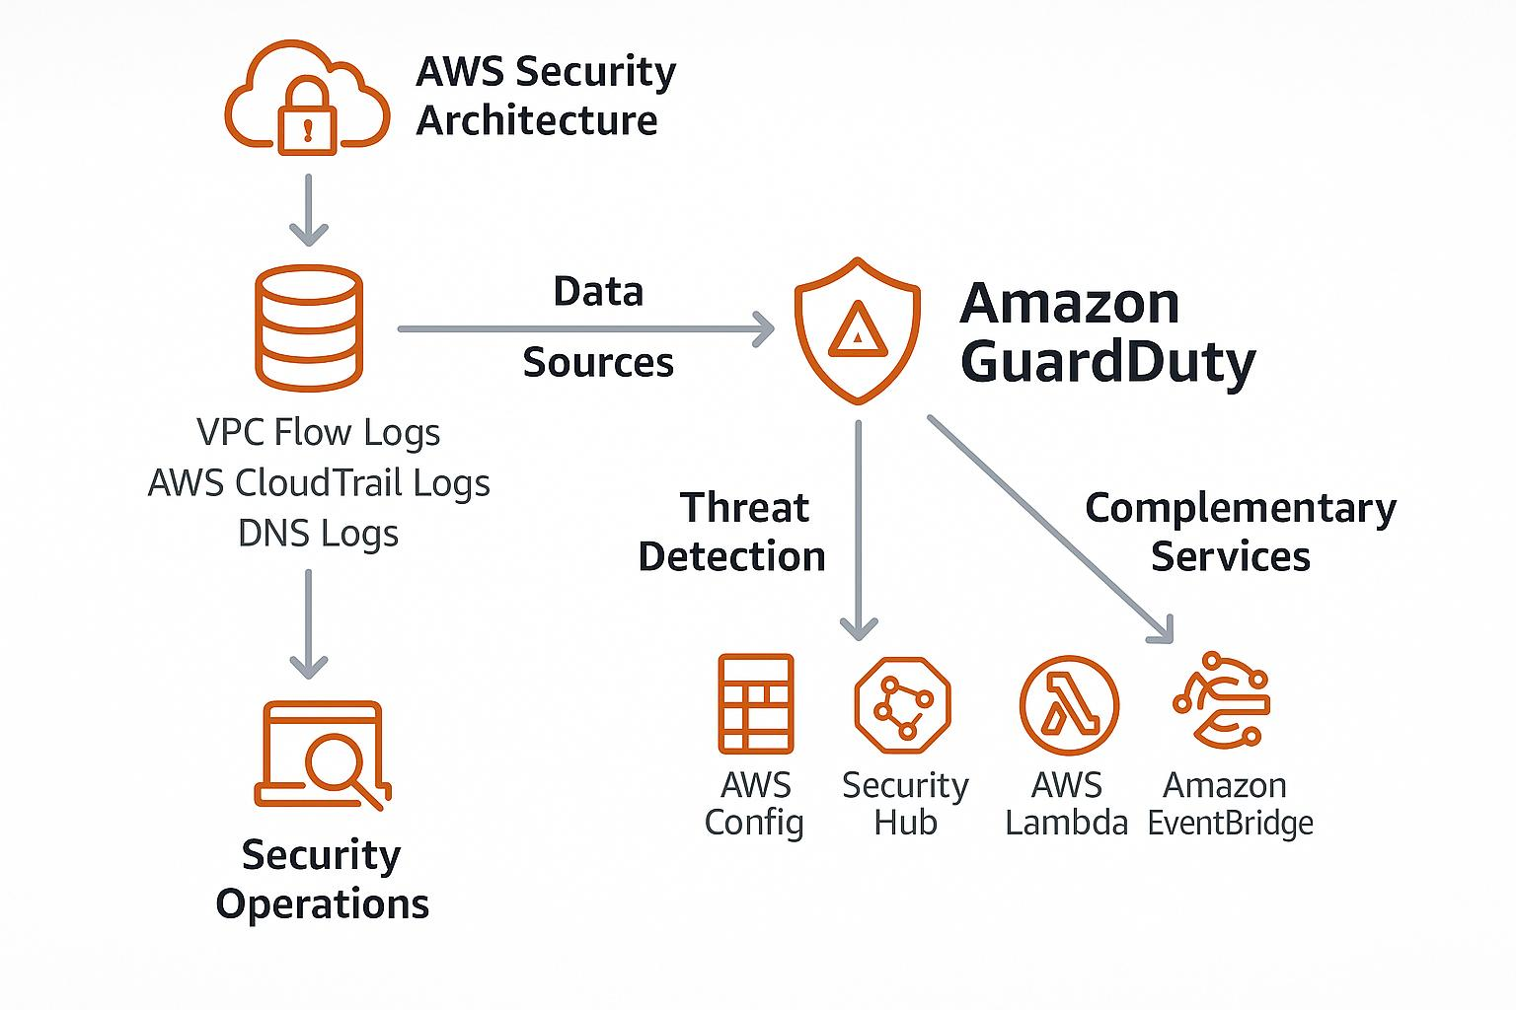

Slide 8
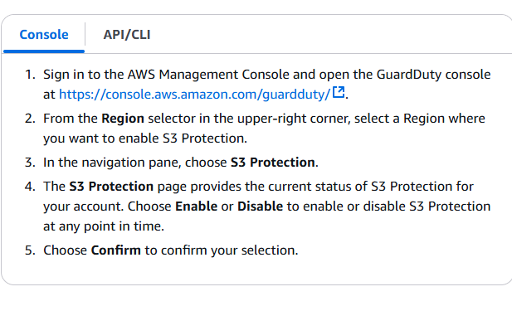

Slide 9
